Slide 1
FILIET: An Information Extraction System for Filipino Disaster-Related Reports
PRESENTED BY
D
KYLE MC HALE B. DELA CRUZ
G
JOHN PAUL F. GARCIA
K
L
VILSON E. LU
KRISTINE MA. DOMINIQUE F. KALAW

Slide 2
1
THE OVERVIEW OF THE CURRENT STATE OF TECHNOLOGY
2
THE OBJECTIVES & SCOPE AND LIMITATIONS OF THE RESEARCH
3
THE THEORETICAL FRAMEWORK
4
WALA PA TO
i
Outline of the Presentation

Slide 3
1
THE OVERVIEW OF THE CURRENT STATE OF TECHNOLOGY
2
THE OBJECTIVES & SCOPE AND LIMITATIONS OF THE RESEARCH
3
THE THEORETICAL FRAMEWORK
i
Outline of the Presentation

Slide 4
1
THE OVERVIEW OF THE FILIET SYSTEM
2
THE OBJECTIVES & SCOPE AND LIMITATIONS OF THE SYSTEM
3
THE ARCHITECTURAL DESIGN OF THE SYSTEM
ii
Outline of the Presentation

Slide 5
1
THE OVERVIEW OF THE FILIET SYSTEM
2
THE OBJECTIVES & SCOPE AND LIMITATIONS OF THE SYSTEM
3
THE ARCHITECTURAL DESIGN OF THE SYSTEM
4
THE INITIAL RESULTS OF THE SYSTEM
ii
Outline of the Presentation

Slide 6
A DISCUSSION OF THE
RESEARCH

Slide 7
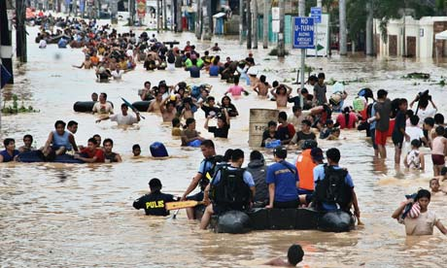

THE OVERVIEW OF THE CURRENT STATE OF TECHNOLOGY
1

Slide 8

THE OVERVIEW OF THE CURRENT STATE OF TECHNOLOGY
1
Philippines
“Social Media Capital of the World”

Slide 9

THE OVERVIEW OF THE CURRENT STATE OF TECHNOLOGY
1
Social media plays a vital role in disaster management.

Slide 10
THE OVERVIEW OF THE CURRENT STATE OF TECHNOLOGY
1
Social Media Data
Information Extraction Module
Type, date and time, and location of the disaster
SOMIDIA

Slide 11
THE OVERVIEW OF THE CURRENT STATE OF TECHNOLOGY
1
Problem?
Filipino Extraction Module vs. English Extraction Module
Filipino: Morphologically Rich Language
Variations in the Filipino Language

Slide 12
THE OBJECTIVES & SCOPE AND LIMITATIONS OF THE RESEARCH
2
GENERAL OBJECTIVE
“To develop an information extraction system that extracts relevant information from disaster-related texts from social media and takes into consideration the different available variations in the Filipino language.”

Slide 13
THE OBJECTIVES & SCOPE AND LIMITATIONS OF THE RESEARCH
2
SPECIFIC OBJECTIVE – SCOPE & LIMITATIONS
To review different information extraction systems in morphologically rich languages.
Review of various information extraction systems.
To understand the different approaches (i.e. architectures, implementation, and components) of implementing an information extraction system.
Notes:
TOPO - Information Extraction System for Natural Disaster Reports From Spanish Newspaper Article (Téllez-Valero, 2005)
Spanish / Free-text / Natural Disasters / Text Classification, Document Feature Extraction / Machine Learning- Based / Precision, Recall, F-measure
VRE Information Extraction System (Pham & Pham, 2012)
Vietnamese / Free text / Real Estate Advertisement / Text Normalization / Rule-Based / Precision, Recall, F-measure
Business Specific Online Information Extraction from German Websites (Lee & Geierhos, 2009)
German / Structured Text / Business Specific Information / Named Entity Recognition, Text Normalization, Attribute-Value Process / Rule-Based / Precision, Recall
Ontology-Based Information Extraction (OBIE) System (Nebhi, 2012)
French / Free text / News article / Tokenization, POS Tagging, Sentence Splitter / Rule-Based, Ontology / Precision, Recall, F-measure, BDM
Social Monitoring for Disaster Management (Cheng et al. 2011)
English, Filipino / Free text / News article, tweets / Tokenization, Sentence Splitter, Language Guesser / Machine-Learning Based / Precision, Recall, F-measure

Slide 14
THE THEORETICAL FRAMEWORK
3
IE SYSTEMS FOR MORPHOLOGICAL LANGUAGES
TOPO – Information Extraction System for Natural Disaster Reports in Spanish
VRE Information Extraction System
SPANISH (Téllez-Valero, 2005)
VIETNAMESE (Pham & Pham, 2012)
Business Specific Online Information Extraction from German Websites
Ontology-Based Information Extraction System (OBIE)
GERMAN (Lee & Geierhos, 2009)
FRENCH (Nebhi, 2012)
Notes:
TOPO - Information Extraction System for Natural Disaster Reports From Spanish Newspaper Article (Téllez-Valero, 2005)
Spanish / Free-text / Natural Disasters / Text Classification, Document Feature Extraction / Machine Learning- Based / Precision, Recall, F-measure
VRE Information Extraction System (Pham & Pham, 2012)
Vietnamese / Free text / Real Estate Advertisement / Text Normalization / Rule-Based / Precision, Recall, F-measure
Business Specific Online Information Extraction from German Websites (Lee & Geierhos, 2009)
German / Structured Text / Business Specific Information / Named Entity Recognition, Text Normalization, Attribute-Value Process / Rule-Based / Precision, Recall
Ontology-Based Information Extraction (OBIE) System (Nebhi, 2012)
French / Free text / News article / Tokenization, POS Tagging, Sentence Splitter / Rule-Based, Ontology / Precision, Recall, F-measure, BDM
Social Monitoring for Disaster Management (Cheng et al. 2011)
English, Filipino / Free text / News article, tweets / Tokenization, Sentence Splitter, Language Guesser / Machine-Learning Based / Precision, Recall, F-measure

Slide 15
THE THEORETICAL FRAMEWORK
3
IE SYSTEMS FOR MORPHOLOGICAL LANGUAGES
Social Monitoring for Disaster Management (SOMIDIA)
FILIPINO (Cheng et al., 2011)
Notes:
TOPO - Information Extraction System for Natural Disaster Reports From Spanish Newspaper Article (Téllez-Valero, 2005)
Spanish / Free-text / Natural Disasters / Text Classification, Document Feature Extraction / Machine Learning- Based / Precision, Recall, F-measure
VRE Information Extraction System (Pham & Pham, 2012)
Vietnamese / Free text / Real Estate Advertisement / Text Normalization / Rule-Based / Precision, Recall, F-measure
Business Specific Online Information Extraction from German Websites (Lee & Geierhos, 2009)
German / Structured Text / Business Specific Information / Named Entity Recognition, Text Normalization, Attribute-Value Process / Rule-Based / Precision, Recall
Ontology-Based Information Extraction (OBIE) System (Nebhi, 2012)
French / Free text / News article / Tokenization, POS Tagging, Sentence Splitter / Rule-Based, Ontology / Precision, Recall, F-measure, BDM
Social Monitoring for Disaster Management (Cheng et al. 2011)
English, Filipino / Free text / News article, tweets / Tokenization, Sentence Splitter, Language Guesser / Machine-Learning Based / Precision, Recall, F-measure

Slide 16
THE OBJECTIVES & SCOPE AND LIMITATIONS OF THE RESEARCH
2
SPECIFIC OBJECTIVE – SCOPE & LIMITATIONS
To identify data source that will be used for the information extraction system.
Example of data source: Facebook and Twitter.
Identifying the data source that will be used in the information extraction will help in choosing appropriate pre-processing techniques and algorithms.
Notes:
Tintin

Slide 17

THE THEORETICAL FRAMEWORK
3
DATA SOURCE
TWITTER

Slide 18
THE OBJECTIVES & SCOPE AND LIMITATIONS OF THE RESEARCH
2
SPECIFIC OBJECTIVE – SCOPE & LIMITATIONS
To review different natural language processing techniques that will pre-process data for the information extraction system.
Examples of the NLP techniques: text classification and text normalization.
Notes:
Vilson

Slide 19
THE OBJECTIVES & SCOPE AND LIMITATIONS OF THE RESEARCH
2
SPECIFIC OBJECTIVE – SCOPE & LIMITATIONS
To review different information extraction techniques.
Examples of IE techniques: Named Entity Recognition (NER), lexical analysis, and coreference analysis.
Notes:
Vilson

Slide 20
THE OBJECTIVES & SCOPE AND LIMITATIONS OF THE RESEARCH
2
SPECIFIC OBJECTIVE – SCOPE & LIMITATIONS
To evaluate existing tools and resources which could be incorporated in the information extraction components of the system.
Existing tools that will be used in building the information extraction system will be reviewed and evaluated.
Examples of NLP tools:
OpenNLP and LingPipe.
Notes:
Kyle

Slide 21
THE THEORETICAL FRAMEWORK
3
TOOLS
Apache OpenNLP is a Java-based library used for commonly used modules in NLP. It has tokenization, sentence segmentation, part-of-speech (POS) tagging, named entity recognition (NER), chunking, parsing and coreference resolution. It also uses maximum entropy and perceptron based machine learning to train the model.
Twitter NLP Tools is a set of tools that are specifically made for use with Twitter data. The system, called T-NER, is composed of five modules: POS Tagger (T-POS), Chunker (T-CHUNK), Capitalization (T-CAP), Name Entity Segmentation (T-SEG), and Named Entity Classification (T-CLASS).
APACHE OPENNLP
TWITTER NLP TOOLS
Notes:
Kyle

Slide 22
THE THEORETICAL FRAMEWORK
3
TOOLS
Waikato Environment Knowledge Analysis (Weka) is a Java-based open source collection of machine learning algorithms that are used in data mining tasks. It contains various tools for preprocessing, classification, regression, clustering and visualization. It provides a library that could be used.
TwitIE is one of the tools that were built on top of the existing ANNIE, a system that offers a wide array of information extraction tools like tokenizer, sentence splitter, POS tagger, gazetteer lists, finite state transducer (from GATE’s built-in regular expression over annotation language), orthomatcher and coreference resolver.
WEKA
TWITIE
Notes:
Kyle

Slide 23
THE THEORETICAL FRAMEWORK
3
TOOLS
ANNIE or A Nearly-New IE System is a system that contains different modules for NLP tasks. ANNIE is part of the GATE framework. ANNIE uses finite state transducers and JAPE rules to implement the modules. ANNIE has a tokenizer, gazetteer, sentence splitter, semantic tagger and name matcher.
ANNIE
Notes:
Kyle

Slide 24
THE OBJECTIVES & SCOPE AND LIMITATIONS OF THE RESEARCH
2
SPECIFIC OBJECTIVE – SCOPE & LIMITATIONS
To determine the metrics for evaluating the information extraction system.
In order to evaluate the information extraction system, the research will determine the metrics to measure the system’s performance.
Notes:
JP

Slide 25
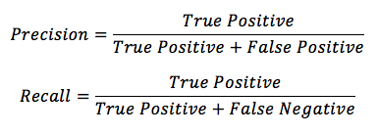


THE THEORETICAL FRAMEWORK
3
EVALUATION METRICS
The two metrics PRECISION and RECALL are often combined and their harmonic mean known as the F-measure.
The kappa allows to measure agreement not only by chance alone. The kappa is the observed agreement beyond chance divided by the maximum agreement beyond chance that is possible for the dataset.
F-MEASURE
KAPPA STATISTICS

Slide 26
THE THEORETICAL FRAMEWORK
3
INFORMATION EXTRACTION
Information extraction is the identification of class of events or relationship and the extraction of relevant arguments of the event or relationship inside a natural language (Grisham, 1997).
Notes:
VIlson

Slide 27
THE THEORETICAL FRAMEWORK
3
INFORMATION EXTRACTION MODULES
TEXT CLASSIFICATION
TOKENIZER
SENTENCE SPLITTER
NORMALIZER
POS TAGGER
GAZETTEER
Notes:
Vilson

Slide 28
THE THEORETICAL FRAMEWORK
3
INFORMATION EXTRACTION MODULES
LEMMATIZER
COREFERENCE RESOLUTION
NAMED ENTITY RECOGNITION
Notes:
Vilson

Slide 29
THE THEORETICAL FRAMEWORK
3
INFORMATION EXTRACTION SYSTEMS
IE² Information Extraction System
(Adaptive-Based Architecture)
EVIUS Information Extraction System
(Adaptive-Based Architecture)
AONE ET AL. (1998)
TURMO & RODRIGUEZ (2000)
LearningPinocchio
(Adaptive-Based Architecture)
SOMIDIA Information Extraction System
(Adaptive-Based Architecture)
CIRAVEGNA & LAVELLI. (2004)
CHUA ET AL. (2013)
Notes:
Vilson

Slide 30
THE THEORETICAL FRAMEWORK
3
INFORMATION EXTRACTION SYSTEMS
POIBEAU GENERAL ARCHITECTURE
(Template-Based Architecture)
POIBEAU (2001)
Notes:
Vilson

Slide 31
A DISCUSSION OF THE
SYSTEM

Slide 32
THE OVERVIEW OF THE FILIET SYSTEM
1
OVERVIEW
Filipino Information Extraction for Twitter (FILIET) is an information extraction system that incorporates the architecture of an adaptive IE system that specifically made to work with Filipino disaster related reports.

Slide 33
THE OBJECTIVES & SCOPE AND LIMITATIONS OF THE SYSTEM
2
GENERAL OBJECTIVE
To develop an information extraction system that extracts relevant information from disaster-related texts from Twitter data and takes into consideration the different available variations of the Filipino language.

Slide 34
THE OBJECTIVES & SCOPE AND LIMITATIONS OF THE SYSTEM
2
SPECIFIC OBJECTIVE – SCOPE & LIMITATIONS
To be able to preprocess the tweets.
Text Normalization,
Text Tokenization,
POS Tagging,
Disaster Keyword Tagging

Slide 35
THE OBJECTIVES & SCOPE AND LIMITATIONS OF THE SYSTEM
2
SPECIFIC OBJECTIVE – SCOPE & LIMITATIONS
To be able to extract relevant features from the tweets.
Presence Features,
Trusted Features,
User,
Tweet Length,
Location

Slide 36
THE OBJECTIVES & SCOPE AND LIMITATIONS OF THE SYSTEM
2
SPECIFIC OBJECTIVE – SCOPE & LIMITATIONS
To classify the type of disaster for each tweet
Typhoons,
Floods, and
Earthquakes

Slide 37
THE OBJECTIVES & SCOPE AND LIMITATIONS OF THE SYSTEM
2
SPECIFIC OBJECTIVE – SCOPE & LIMITATIONS
To extract relevant information common among the types of disaster (i.e. location)
Time and Location

Slide 38
THE OBJECTIVES & SCOPE AND LIMITATIONS OF THE SYSTEM
2
SPECIFIC OBJECTIVE – SCOPE & LIMITATIONS
To extract disaster-specific information from the tweet given the type of disaster
Typhoon: Typhoon Name, Signal Number, Wind Speed
Earthquake: Intensity & Magnitude
Flood: Depth, Road Passable

Slide 39
THE OBJECTIVES & SCOPE AND LIMITATIONS OF THE SYSTEM
2
SPECIFIC OBJECTIVE – SCOPE & LIMITATIONS
To be able to handle TXTSPK and code-switching variations of the Filipino language.
TXTSPK Variation
Code Switching Variation

Slide 40
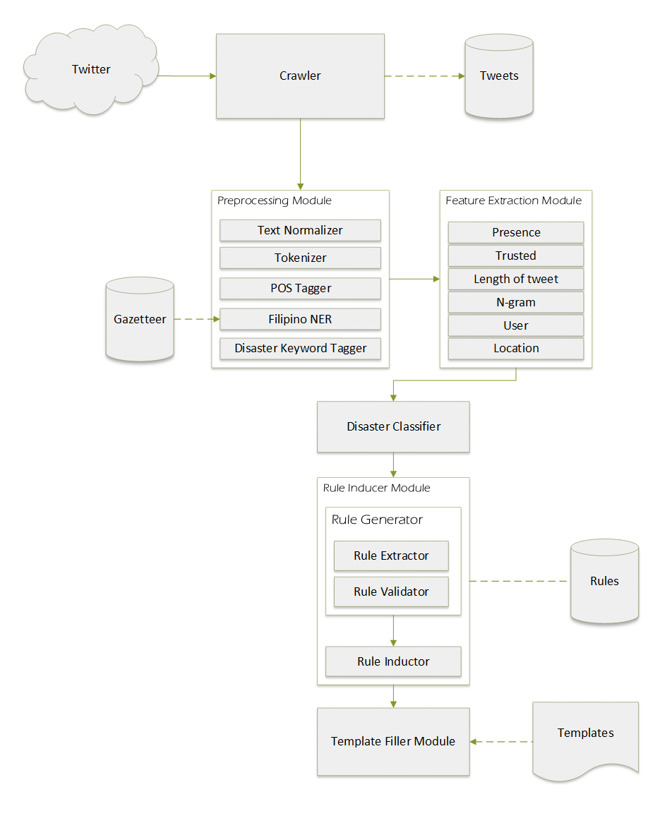
THE ARCHITECTURAL DESIGN OF THE SYSTEM
3

Slide 42
THE ARCHITECTURAL DESIGN OF THE SYSTEM
3

Slide 44
THE ARCHITECTURAL DESIGN OF THE SYSTEM
3
DATA SOURCES
The data that will be collected will come from the tweets of the trusted Twitter accounts. Some of it will be provided by the Twitter Web Crawler developed by the De La Salle – College of Computer Studies, while the rest will come from the Crawler module to be discussed in the next section. The list of trusted Twitter accounts is based on the list provided by SOMIDIA.
The gazetteer is a text file that contains the list of names and locations to identify the proper nouns in the tweets. This will be used for the Filipino NER module. The plan is to update and use SOMIDIA’s gazetteer.
TWITTER / TWEETS
GAZETTEER
Notes:
Tintin

Slide 45
THE ARCHITECTURAL DESIGN OF THE SYSTEM
3
DATA SOURCES
The rules generated by the Rule Induction module will be stored in the database. Then, the Rule Inductor module will access the database to retrieve the rules.
For the templates, there will be two types of templates: general and specific. General templates are templates that will contain the following fields: (1) time, (2) location, and (3) type of disaster. For each type of disaster, there is a corresponding template. For typhoons, the template will have fields for: the typhoon name, signal number, and wind speeds. For earthquakes, the template will have a field for the magnitude. Lastly, for floods, the template will have a field for how deep the flood is and if the flood is passable to vehicles or not.
RULES
TEMPLATES
Notes:
TIntin

Slide 46
THE ARCHITECTURAL DESIGN OF THE SYSTEM
1
CRAWLER MODULE
This module will be crawling Twitter to retrieve tweets. The system will continuously collect the tweets using Twitter’s Stream API. The system will use a Twitter account where it follows the trusted users. The system will use a library called, Twitter4j, to implement the crawler method.
Notes:
JP

Slide 47
THE ARCHITECTURAL DESIGN OF THE SYSTEM
3
PREPROCESSING MODULE
The main responsibilities of the text normalizer are the following: (1) to convert the TXTSPK format of the tweets into full-word format so that the information when extracted will be consistent;
(2) to correct the misspellings found in the tweets; (3) remove emoticons, links, and hashtags.
INPUT | OUTPUT
<tweet> Kawawa naman nilindol sa Antique. <//33 </tweet> | <tweet> Kawawa naman nilindol sa Antique. </tweet>
<tweet> “”@ANCALERTS: Magnitude 4.3 quake jolts Antique, Boracay http://t.co/c2BczJEa6Y"" Lindol everywhere :3</tweet> | <tweet> Magnitude 4.3 quake jolts Antique, Boracay Lindol everywhere </tweet>
TEXT NORMALIZER
SAMPLE INPUT/OUTPUT
Notes:
JP

Slide 48
THE ARCHITECTURAL DESIGN OF THE SYSTEM
3
PREPROCESSING MODULE
The tokenizer will split the input tweets into tokens like numbers, punctuations, words, abbreviations and other special characters like emoticons, hashtags, mentions and the like.
INPUT | OUTPUT
<tweet> Kawawa naman nilindol sa Antique. </tweet> | <tweet> [“Kawawa”, “naman”, “nilindol”, “sa”, “Antique”, “.”] </tweet>
<tweet> Magnitude 4.3 quake jolts Antique, Boracay Lindol everywhere </tweet> | <tweet> [“Magnitude”, “4.3”, “quake”, “jolts”, “Antique”, “,”, “Boracay”, “Lindol”, “everywhere”] </tweet>
TOKENIZER
SAMPLE INPUT/OUTPUT
Notes:
JP

Slide 49
THE ARCHITECTURAL DESIGN OF THE SYSTEM
3
PREPROCESSING MODULE
The POS tagger will tag each of a token with its corresponding part-of-speech. Each of the tokens can be tagged as a noun, a verb, an adjective, an adverb or others.
INPUT | OUTPUT
<tweet> [“Kawawa”, “naman”, “nilindol”, “sa”, “Antique”, “.”] </tweet> | <tweet> [“Kawawa_ADUN”, “naman_NPRO”, “nilindol”, “sa_DECN”, “Antique_NN”, “._PSNS”] </tweet>
<tweet> [“Magnitude”, “4.3”, “quake”, “jolts”, “Antique”, “,”, “Boracay”, “Lindol”, “everywhere”] </tweet> | <tweet> [“Magnitude_NN:U”, “4.3”, “quake_NN”, “jolts_NNS”, “Antique_NN”, “,_PSNS”, “Boracay”, “Lindol”, “everywhere_RB” </tweet>
POS TAGGER
SAMPLE INPUT/OUTPUT
Notes:
JP

Slide 50
THE ARCHITECTURAL DESIGN OF THE SYSTEM
3
PREPROCESSING MODULE
The Filipino NER will be the one who will identify those proper nouns in the tweets. It will use, as a reference, a gazetteer containing all Filipino NER.
INPUT | OUTPUT
<tweet> [“Kawawa”, “naman”, “nilindol”, “sa”, “Antique”, “.”] </tweet> | <tweet> [“Kawawa_ADUN”, “naman_NPRO”, “nilindol”, “sa_DECN”, “<location=”Antique_NN”>, “._PSNS”] </tweet>
<tweet> [“Magnitude”, “4.3”, “quake”, “jolts”, “Antique”, “,”, “Boracay”, “Lindol”, “everywhere”] </tweet> | <tweet> [“Magnitude_NN:U”, “4.3”, “quake_NN”, “jolts_NNS”, <location=“Antique_NN”>, “,_PSNS”, <location=“Boracay”>, “Lindol”, “everywhere_RB” </tweet>
FILIPINO NER
SAMPLE INPUT/OUTPUT
Notes:
JP

Slide 51
THE ARCHITECTURAL DESIGN OF THE SYSTEM
3
PREPROCESSING MODULE
The disaster keyword tagger module is the module responsible for enclosing the disaster seed words present in the input tweet with a disaster tag.
INPUT | OUTPUT
<tweet> [“Kawawa”, “naman”, “nilindol”, “sa”, “Antique”, “.”] </tweet> | <tweet> [“Kawawa_ADUN”, “naman_NPRO”, “<disaster=nilindol/>”, “sa_DECN”, “<location=”Antique_NN/”>, “._PSNS”] </tweet>
<tweet> [“Magnitude”, “4.3”, “quake”, “jolts”, “Antique”, “,”, “Boracay”, “Lindol”, “everywhere”] </tweet> | <tweet> [“Magnitude_NN:U”, “4.3”, “quake_NN”, “jolts_NNS”, <location=“Antique_NN”>, “,_PSNS”, <location=“Boracay”>, <disaster=“Lindol”>, “everywhere_RB” </tweet>
DISASTER KEYWORD TAGGER
SAMPLE INPUT/OUTPUT
Notes:
JP

Slide 52
THE ARCHITECTURAL DESIGN OF THE SYSTEM
3
FEATURE EXTRACTION MODULE
This module is responsible for extracting the feature from the tweet. The module will extract the presence of disaster words, tweet length, character n-gram, user, location, and trusted accounts.
FEATURE EXTRACTOR
INPUT TWEET | Hashtags | Links | Emoticon | Mention | RT
“”@ANCALERTS: Magnitude 4.3 quake jolts Antique, Boracay http://t.co/c2BczJEa6Y"" Lindol everywhere :3 | 0 | 1 | 1 | 1 | 0
SAMPLE DATASET
Notes:
JP

Slide 53
THE ARCHITECTURAL DESIGN OF THE SYSTEM
3
DISASTER CLASSIFIER MODULE
The tweets will be classified first to the type of disaster: typhoon, earthquakes, and flood. This is to determine the type of information that will be extracted from the tweets.
INPUT | OUTPUT
<tweet> [“Kawawa”, “naman”, “nilindol”, “sa”, <location= “Antique”/>, “.”] </tweet> | <tweet disaster=”earthquake”> [“Kawawa_ADUN”, “naman_NPRO”, “<disaster=nilindol/>”, “sa_DECN”, “<location=”Antique_NN/”>, “._PSNS”] </tweet>
<tweet> [ “Magnitude”, “4.3”, “quake”, “jolts”, “<location= Antique/>, “,”, “<location=Boracay/>, “Lindol”, “everywhere”] </tweet> | <tweet disaster=”earthquake”> [“Magnitude_NN:U”, “4.3”, “quake_NN”, “jolts_NNS”, <location=“Antique_NN”>, “,_PSNS”, <location=“Boracay”>, <disaster=“Lindol”>, “everywhere_RB” </tweet>
DISASTER CLASSIFIER
SAMPLE INPUT/OUTPUT

Slide 54
THE ARCHITECTURAL DESIGN OF THE SYSTEM
3
INFORMATION EXTRACTION MODULE
The Rule Extractor will extract all the possible rules for the tweets by making use of different patterns that can be found in the input tweet. To generate the rules, the system will identify the seed words or the words that will be extracted that are present in the tweets. With the seed words, the system will apply the windowing technique around the seed words to extract as much patterns of combination of words, which, in turn can be converted to become extraction rules. To generate/extract as much patterns, the researchers will try various Maximum Windows Sizes, W = 1, 2, 3. After generating/extracting the patterns, they will now be converted to extraction rules
RULE EXTRACTOR

Slide 55
THE ARCHITECTURAL DESIGN OF THE SYSTEM
3
INFORMATION EXTRACTION MODULE
INPUT | OUTPUT
<tweet disaster=”earthquake”> [“Kawawa_ADUN”, “naman_NPRO”, “<disaster=nilindol/>”, “sa_DECN”, “<location=”Antique_NN/”>, “._PSNS”] </tweet> | <string: sa><location><string: “.”>AS Location
 | <string: naman><disaster><string:sa> AS Disaster
INPUT | OUTPUT
<tweet disaster=”earthquake”> [“Magnitude_NN:U”, “4.3”, “quake_NN”, “jolts_NNS”, <location=“Antique_NN”>, “,_PSNS”, <location=“Boracay”>, <disaster=“Lindol”>, “everywhere_RB” </tweet> | <string: magnitude><number>AS Intensity
 | <POS: NNS><location><POS: PSNS>AS Location
 | <POS: PSNS><location><disaster> AS Location
 | <location><disaster><string: everywhere> AS Disaster
SAMPLE INPUT/OUTPUT A
SAMPLE INPUT/OUTPUT B
Notes:
Vilson

Slide 56
THE ARCHITECTURAL DESIGN OF THE SYSTEM
3
INFORMATION EXTRACTION MODULE
The Rule Validator module is responsible for cleaning up the excess rules. This is done to improve the performance of the information extraction rules. Rules that are too specific will be removed, because the rules can only affect small part of the dataset. Rules that are too general will also be removed, because they might extract unwanted information. Rules are specific if they only occurred once in the rule extractor. Rules are general if they extract more than the occurrence count.
RULE VALIDATOR

Slide 57
THE ARCHITECTURAL DESIGN OF THE SYSTEM
3
INFORMATION EXTRACTION MODULE
The Rule Inductor module will accept a tokenized and tagged tweets. The tweets contain XML tags that tells the type of disaster, location, time and other information. The, the plan is to generate rules using machine learning techniques and apply the rules to extract the information needed.
RULE INDUCTOR

Slide 58
THE ARCHITECTURAL DESIGN OF THE SYSTEM
3
TEMPLATE FILLER MODULE
After the rule induction module, the extracted information will now be placed to a slot in the template. Each type of disaster will have a different type of template as they have different information that can be extracted.
TEMPLATE FILLER

Slide 59
THE ARCHITECTURAL DESIGN OF THE SYSTEM
3
TEMPLATE FILLER MODULE
EARTHQUAKE TEMPLATE
GENERAL INFORMATION:
DISASTER | Earthquake
LOCATION | Antique
TIME | --
DISASTER-SPECIFIC INFORMATION:
INTENSITY | --
EARTHQUAKE TEMPLATE
GENERAL INFORMATION:
DISASTER | Earthquake
LOCATION | Boracay, Antique
TIME | --
DISASTER-SPECIFIC INFORMATION:
INTENSITY | Magnitude 4.3
SAMPLE OUTPUT A
SAMPLE OUTPUT B

Slide 60
THE INITIAL RESULTS OF THE SYSTEM
4
DISASTER CLASSIFIER
RESULTS GO HERE. ☺

Slide 61
Demo.

Slide 62
Questions.

Slide 63
Thank you for listening.

